Slide 1
Online voting system using reactjs
Web development project
SUBMITTED TO- PROF. ANIRBAN CHOUDARY
PRESENTED BY- SAKSHI PATIDAR
SCHOLAR ID- 212120114
MCA IInd sem

Slide 2
Features Added-
ADD VOTER
DELETE VOTER
EDIT VOTER
VIEW VOTER
VOTE

Slide 3
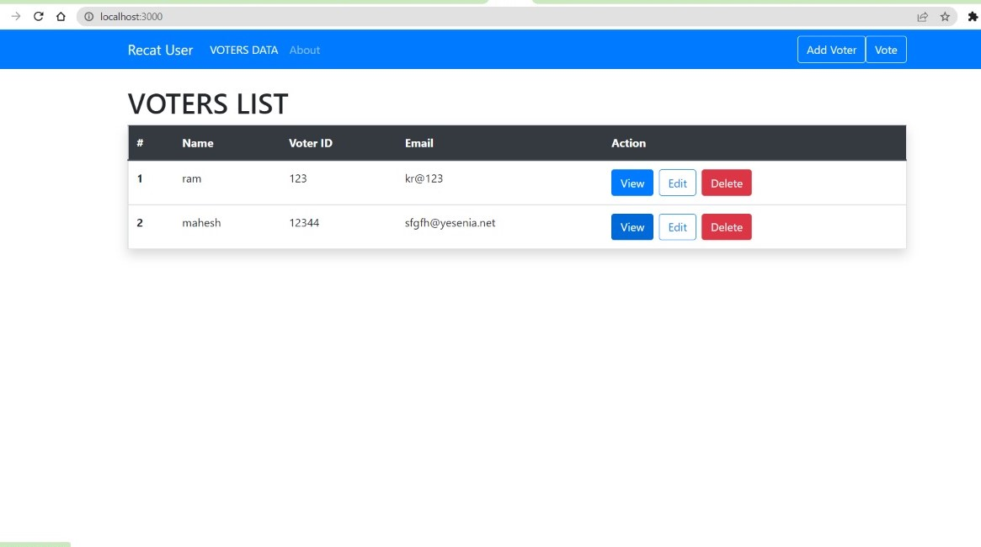
VOTER LIST PAGE

Slide 4
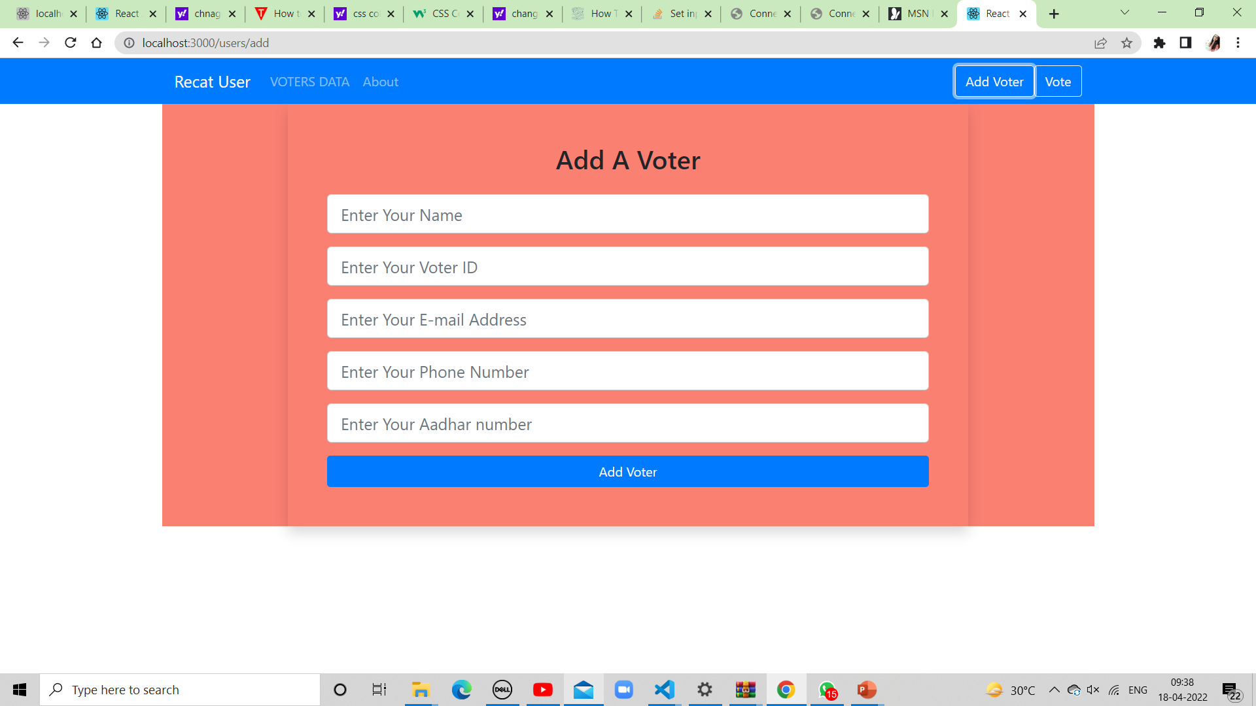
Adding voters Data

Slide 5
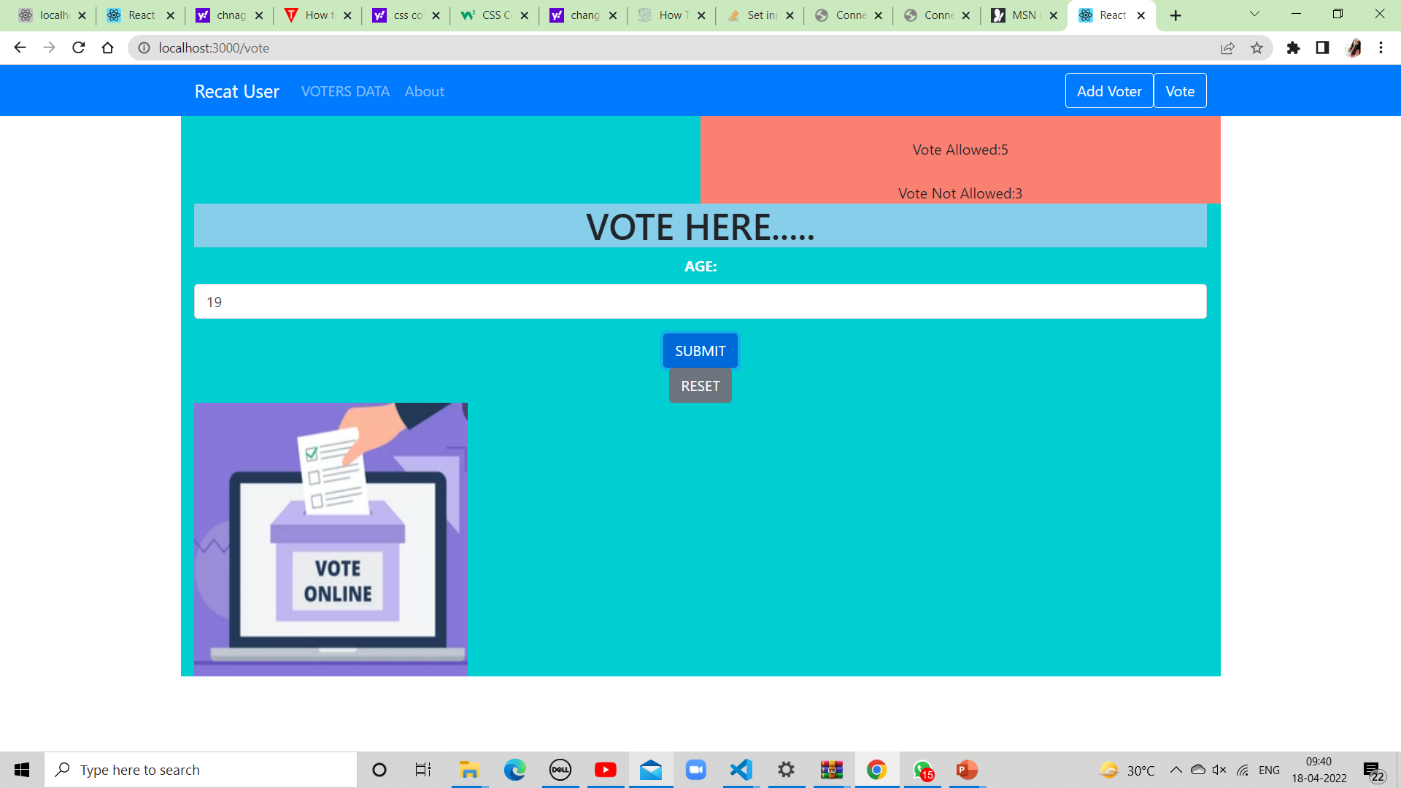
VOTING PAGE

Slide 6
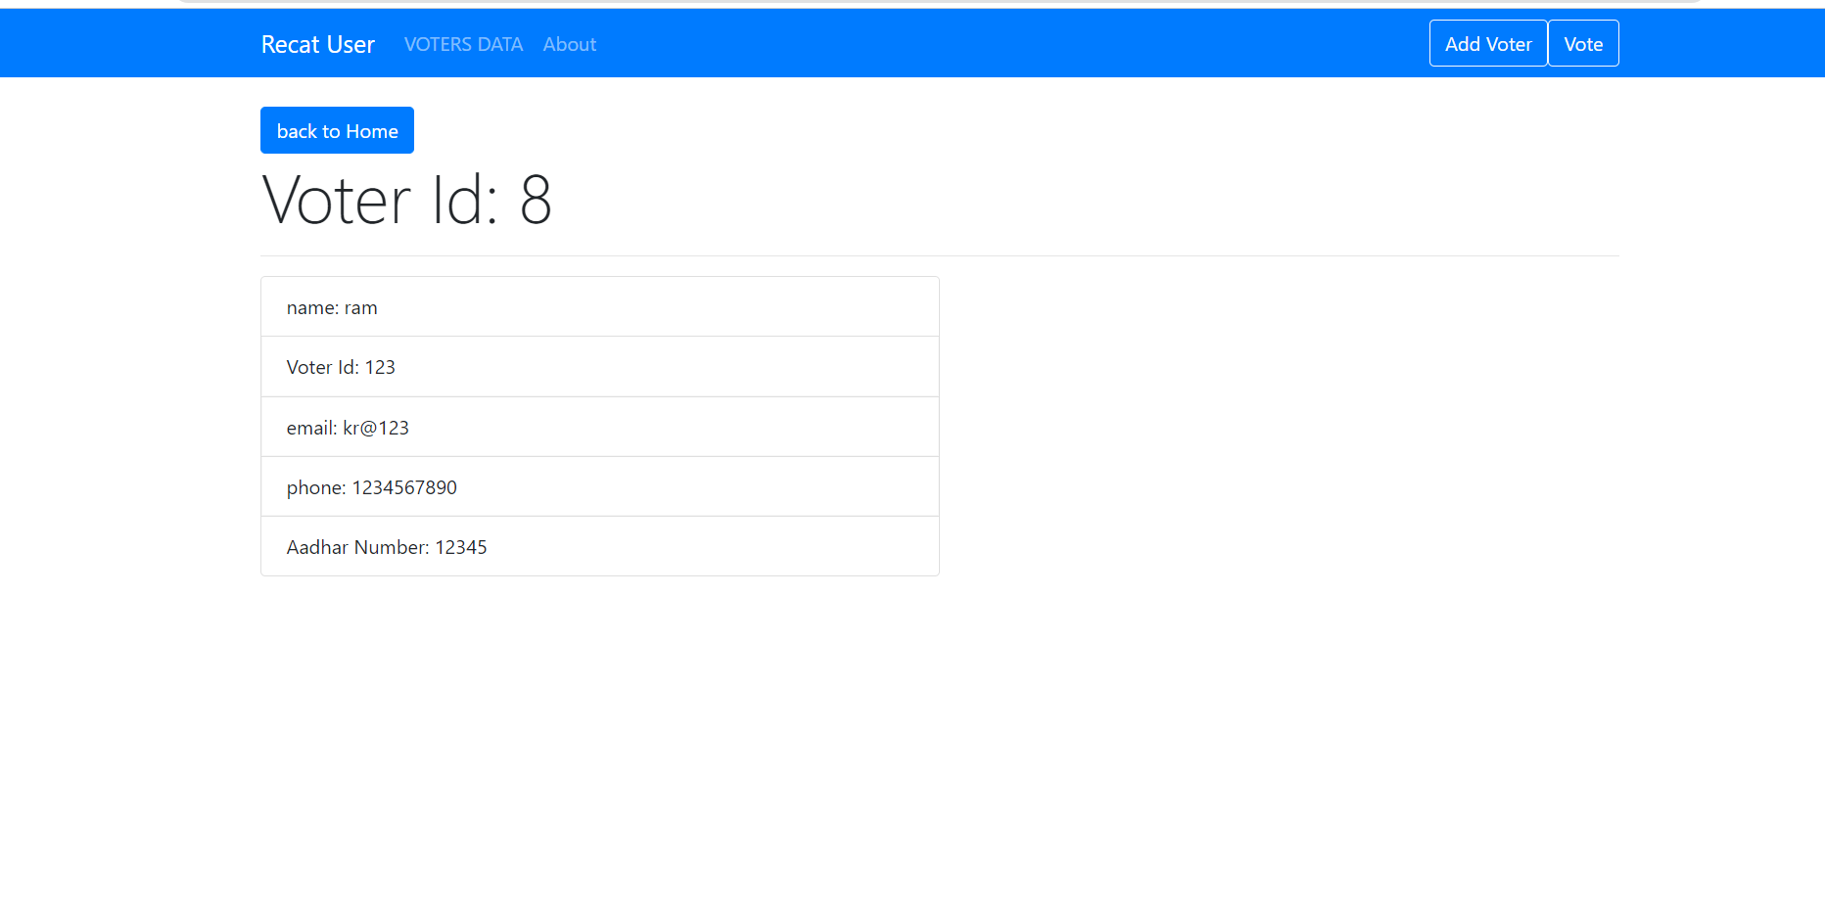
VIEW VOTERS PAGE

Slide 7
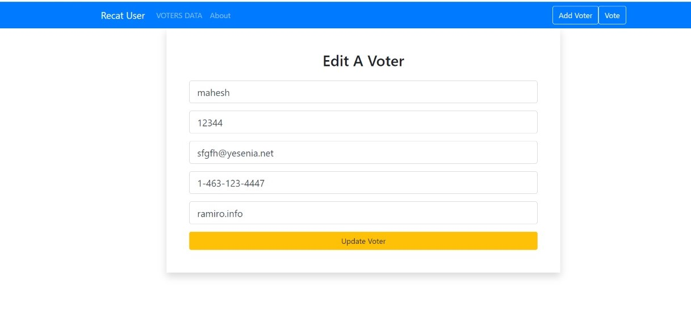
EDIT DATA

Slide 8

PAGE NOT FOUND

Slide 9







Components
Layout
Pages
Users
User.js
Navbar.js
About.js
Voter.js
AddUser.js
EditUser.js
Home.js
NotFound.js

Slide 10
React-Router-Dom : React Router Dom is used to build single-page applications i.e. applications that have many pages or components but the page is never refreshed. It allows us to display pages and allow users to navigate them. It is a fully-featured client and server- This process is called Routing and it is made possible with the help of React Router. Install -(npm i react-router-dom) Router(usually imported as BrowserRouter): It is the parent component that is used to store all of the other components. Everything within this will be part of the routing functionality.
AXIOS-Axios, which is a popular library is mainly used to send asynchronous HTTP requests to REST endpoints. This library is very useful to perform CRUD operations.

Slide 11
useState- The React useState Hook allows us to track
state in a function component.
State generally refers to data or properties that need
to be tracking in an application.
Useparms- useParams is a React Router Hook that allows you to access
dynamic parameters in the URL. useParams returns an object of key:value
pairs of URL parameters. The key is the name you've assigned in the URL;
the value is what is being passed in.

Slide 12
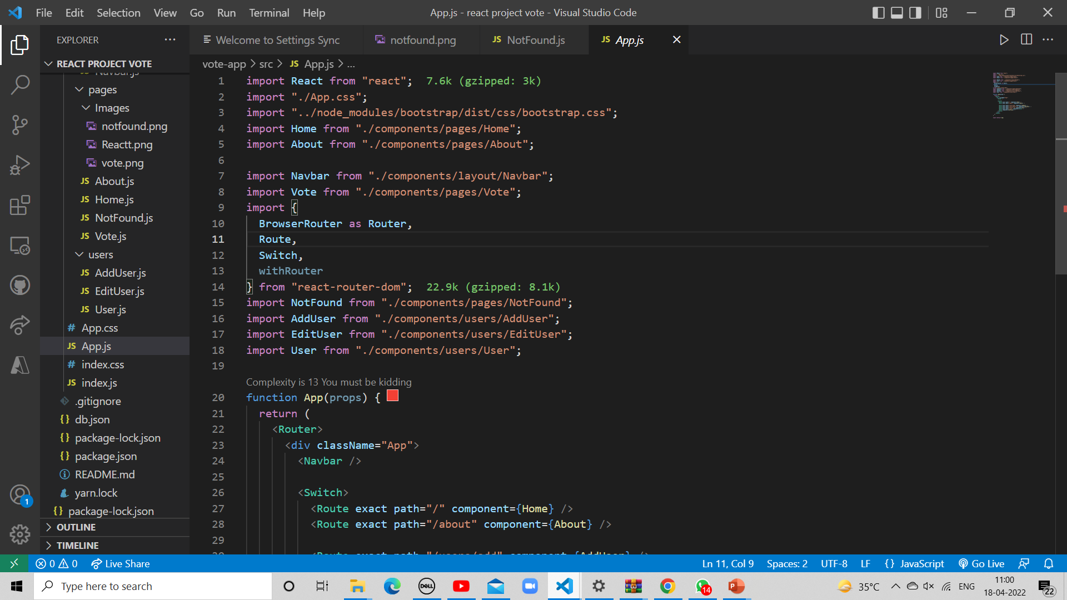
App.js

Slide 13
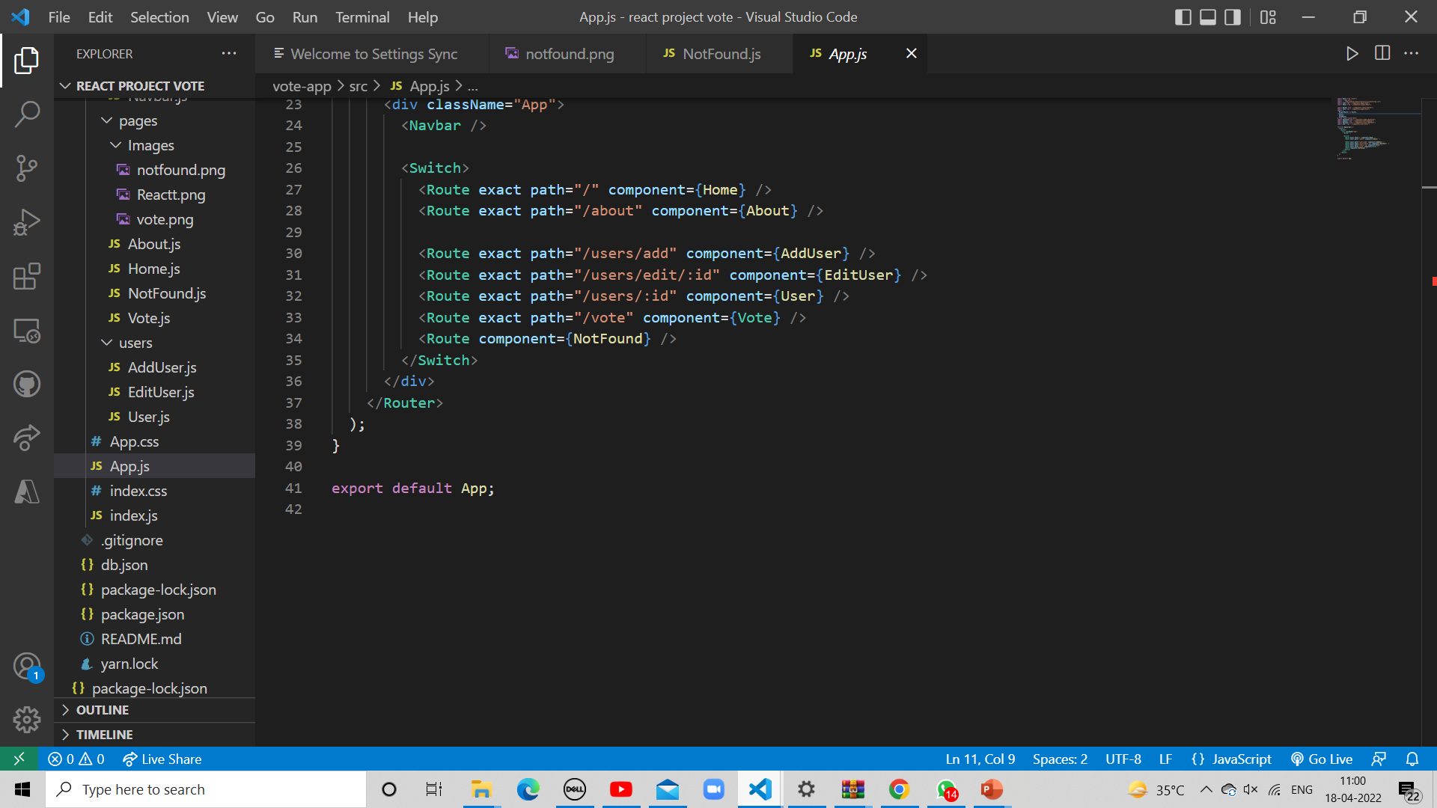

Slide 14
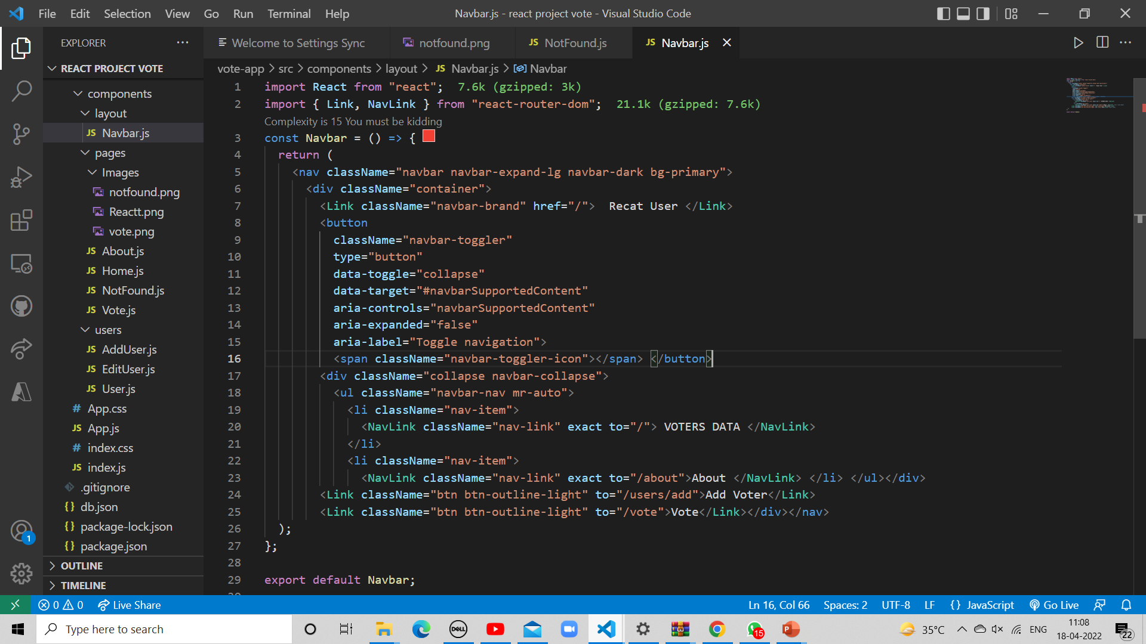
Navbar.js (components->layout->Navbar.js)

Slide 15
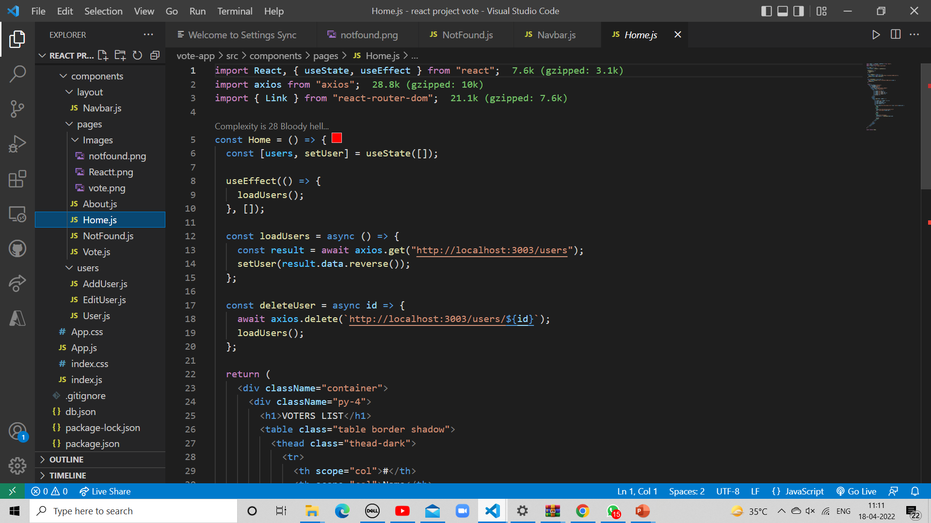
Home.js (components->Pages->Home.js)

Slide 16
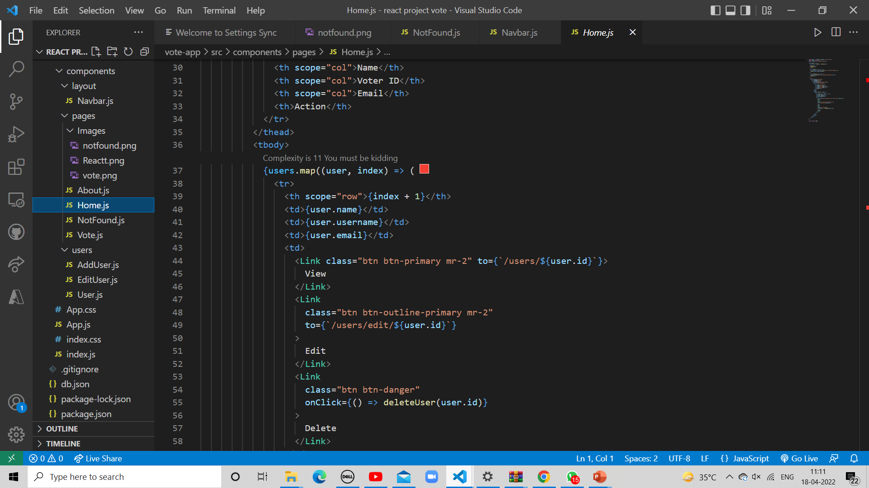

Slide 17
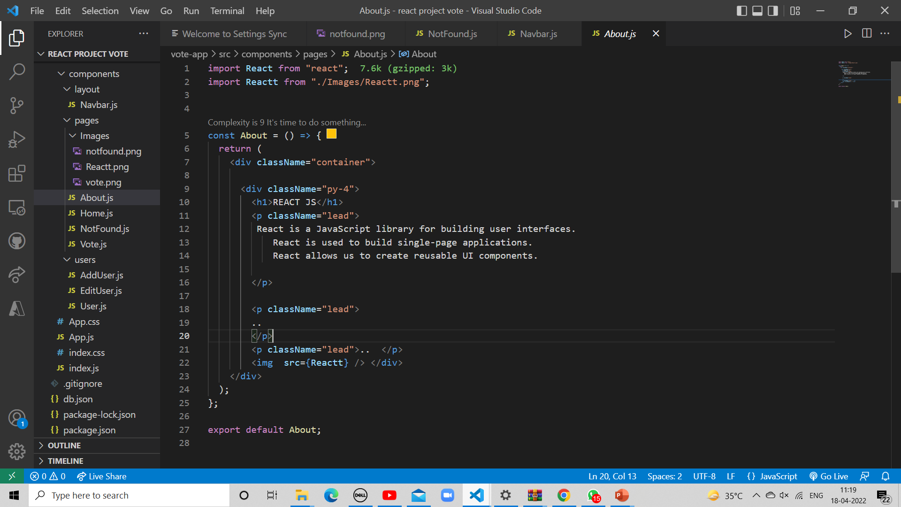
About.js (components->Pages->About.js)

Slide 18
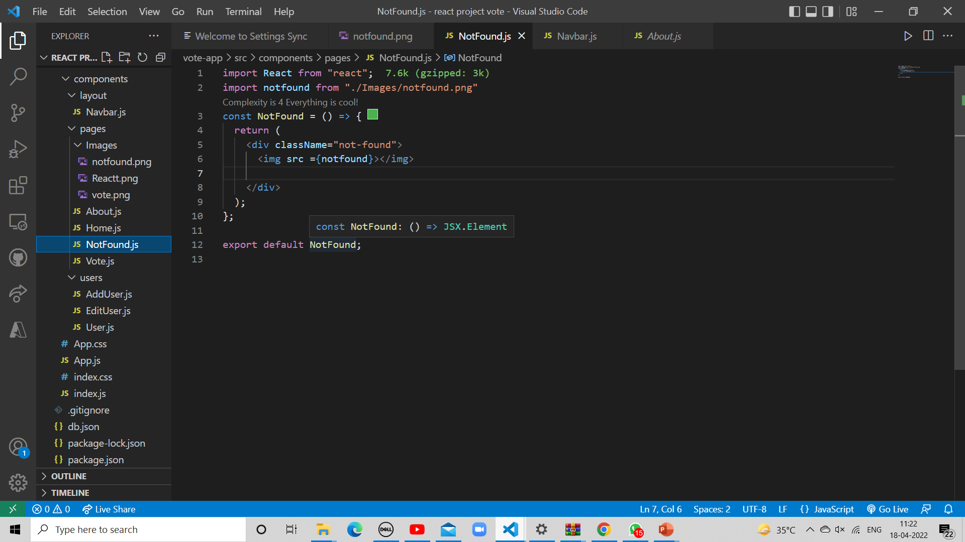
NotFound.js (components->Pages-> NotFound.js)

Slide 19
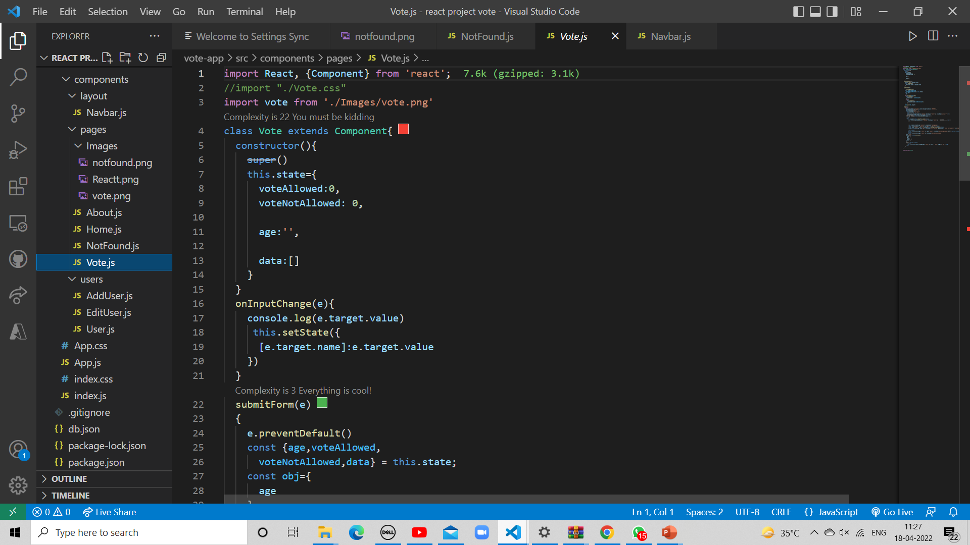
Vote.js (components->Pages-> Vote.js)

Slide 20
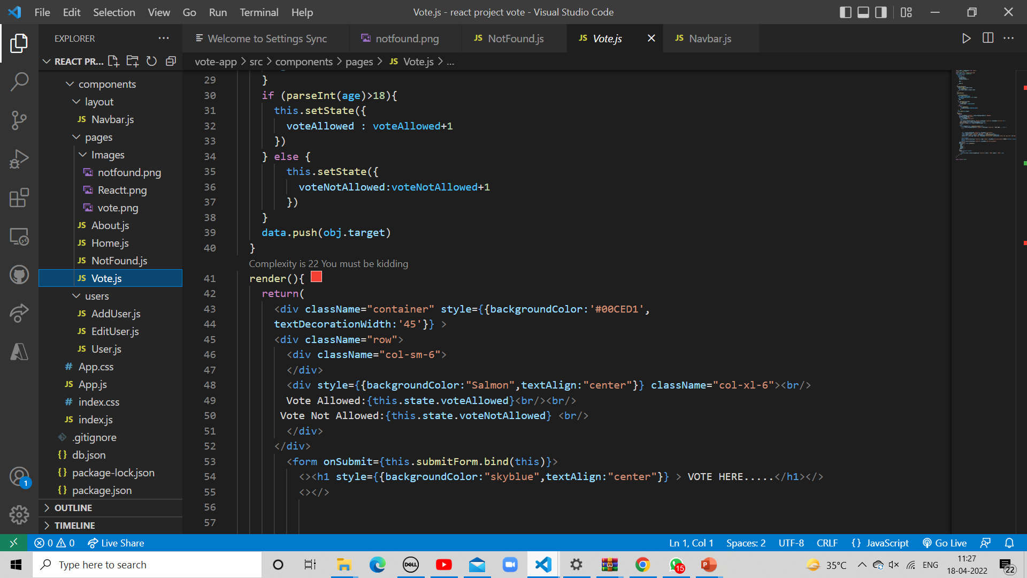

Slide 21
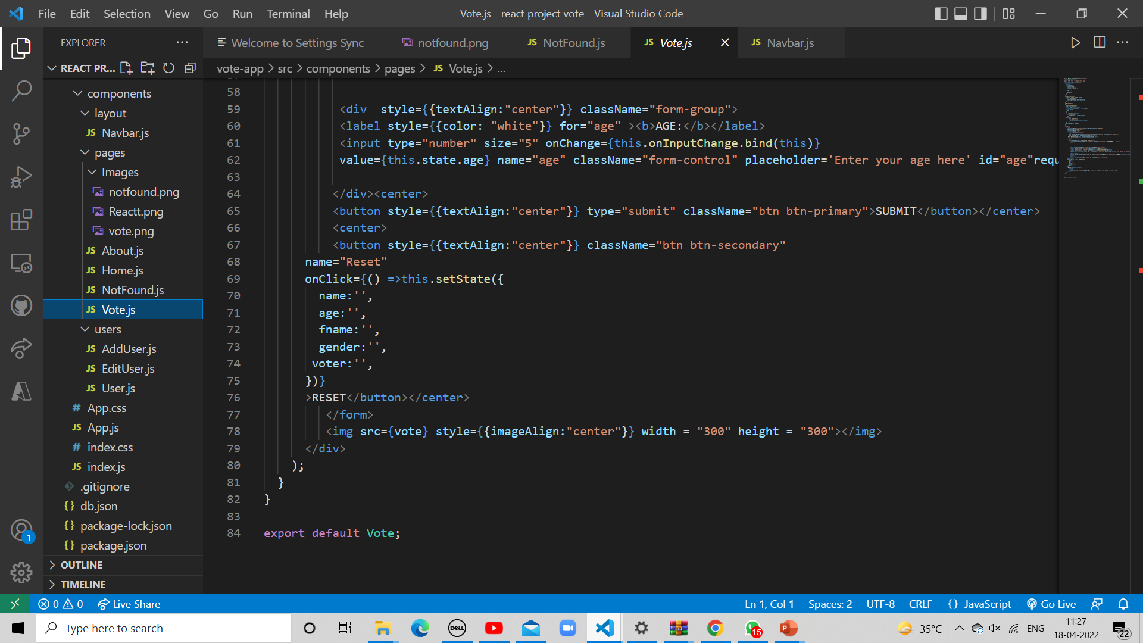

Slide 22
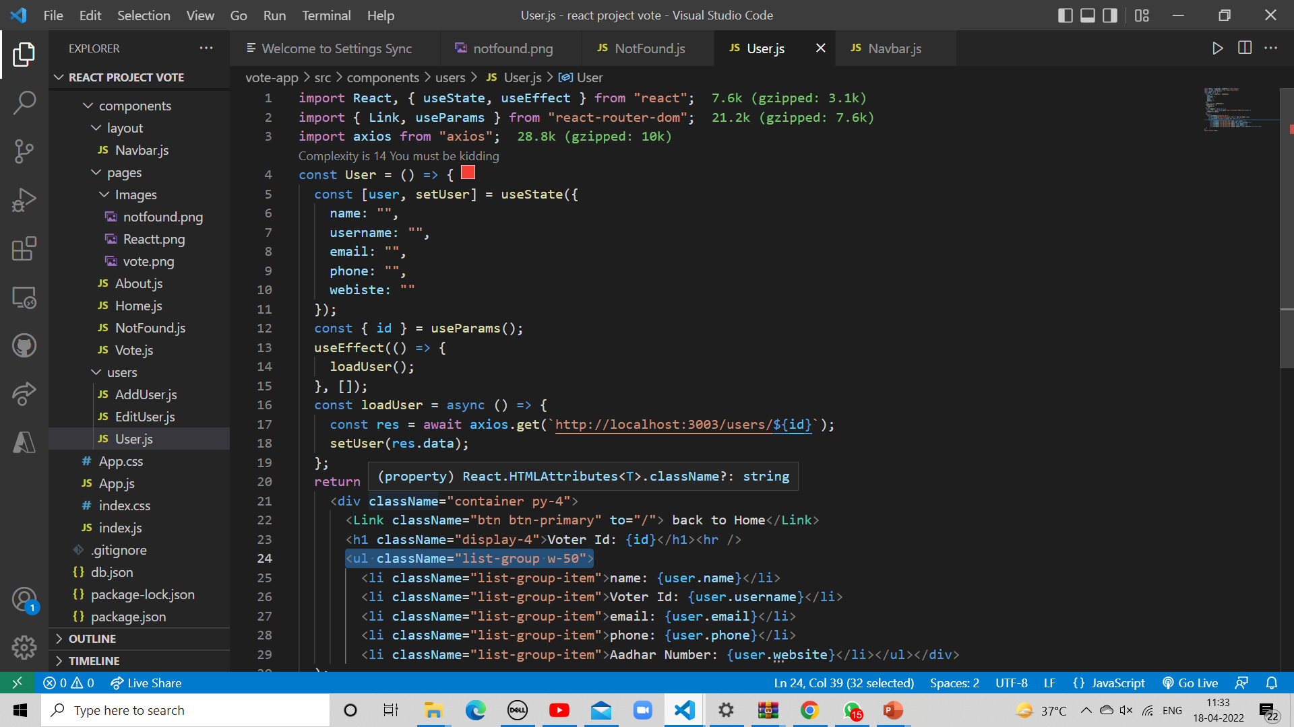
User.js

Slide 23
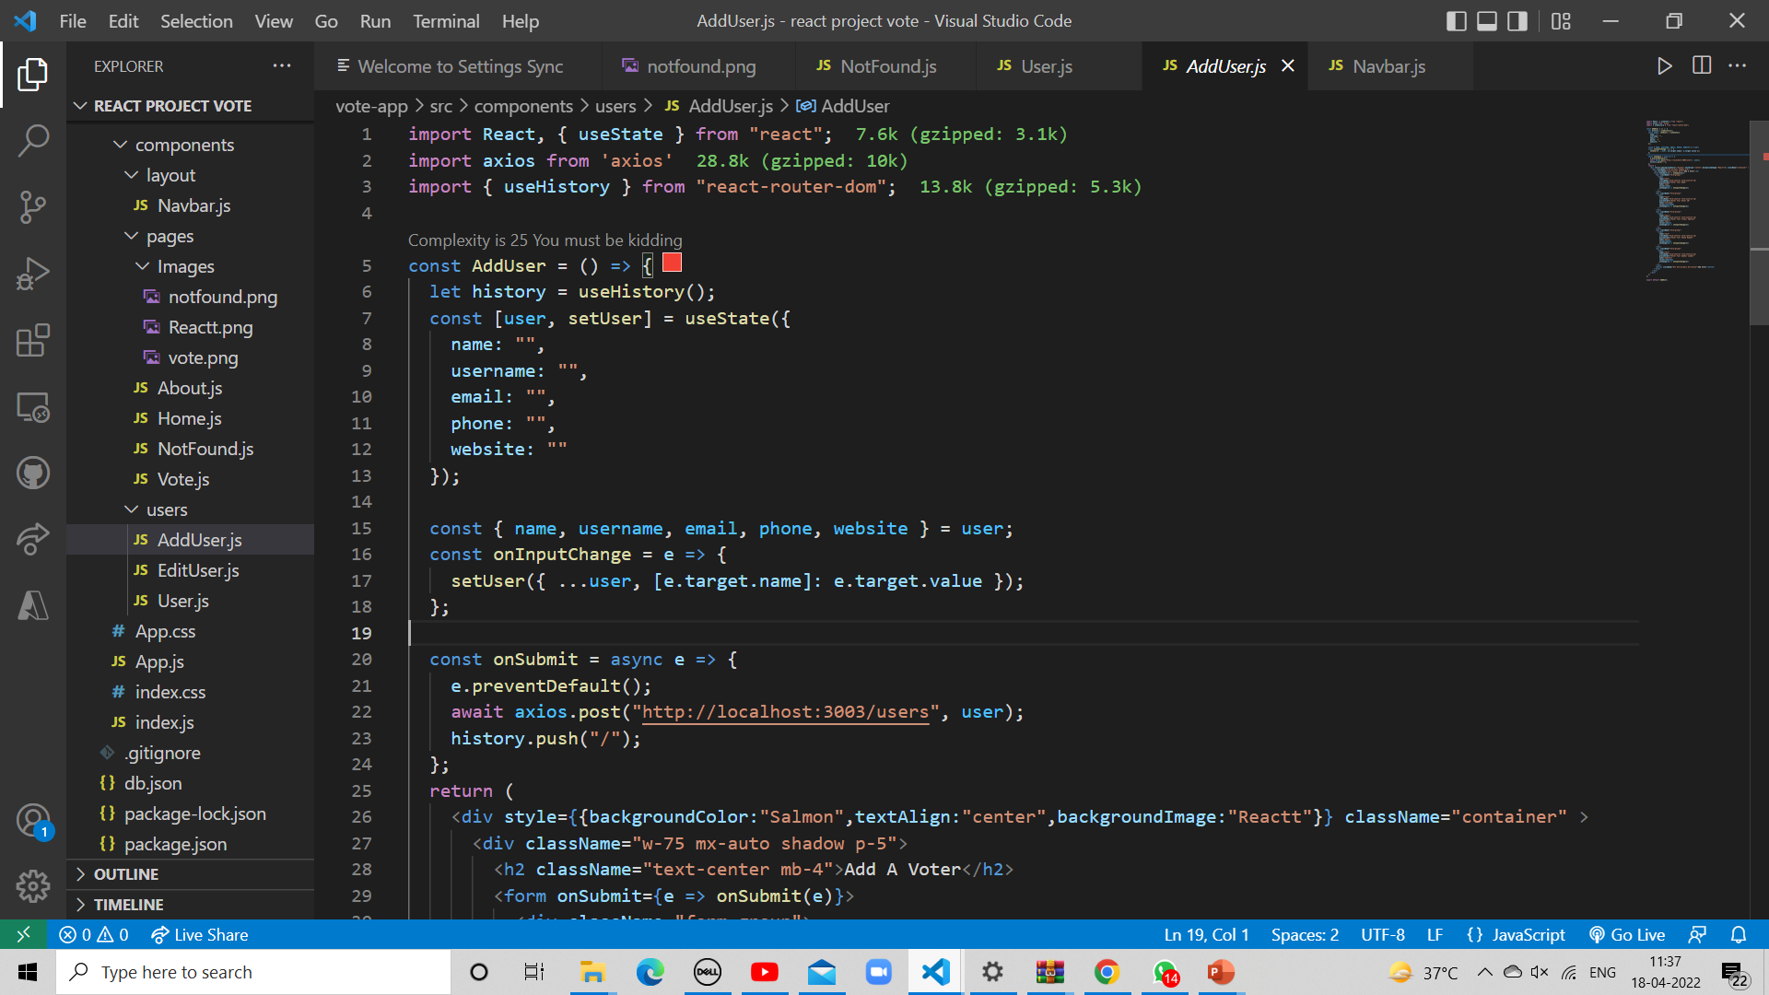
AddUser.js

Slide 24
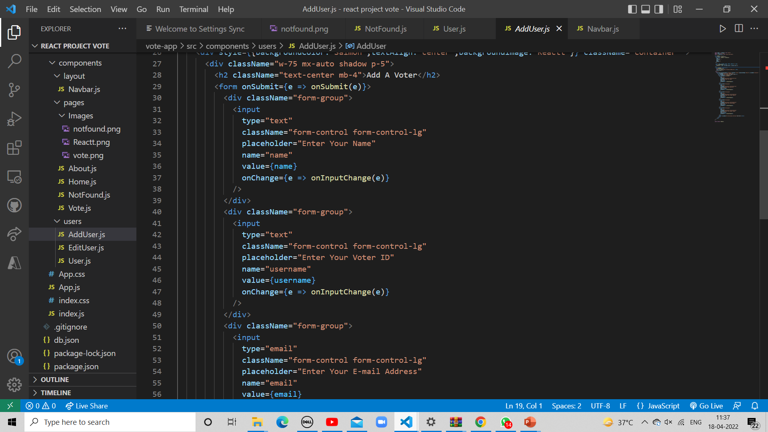

Slide 25
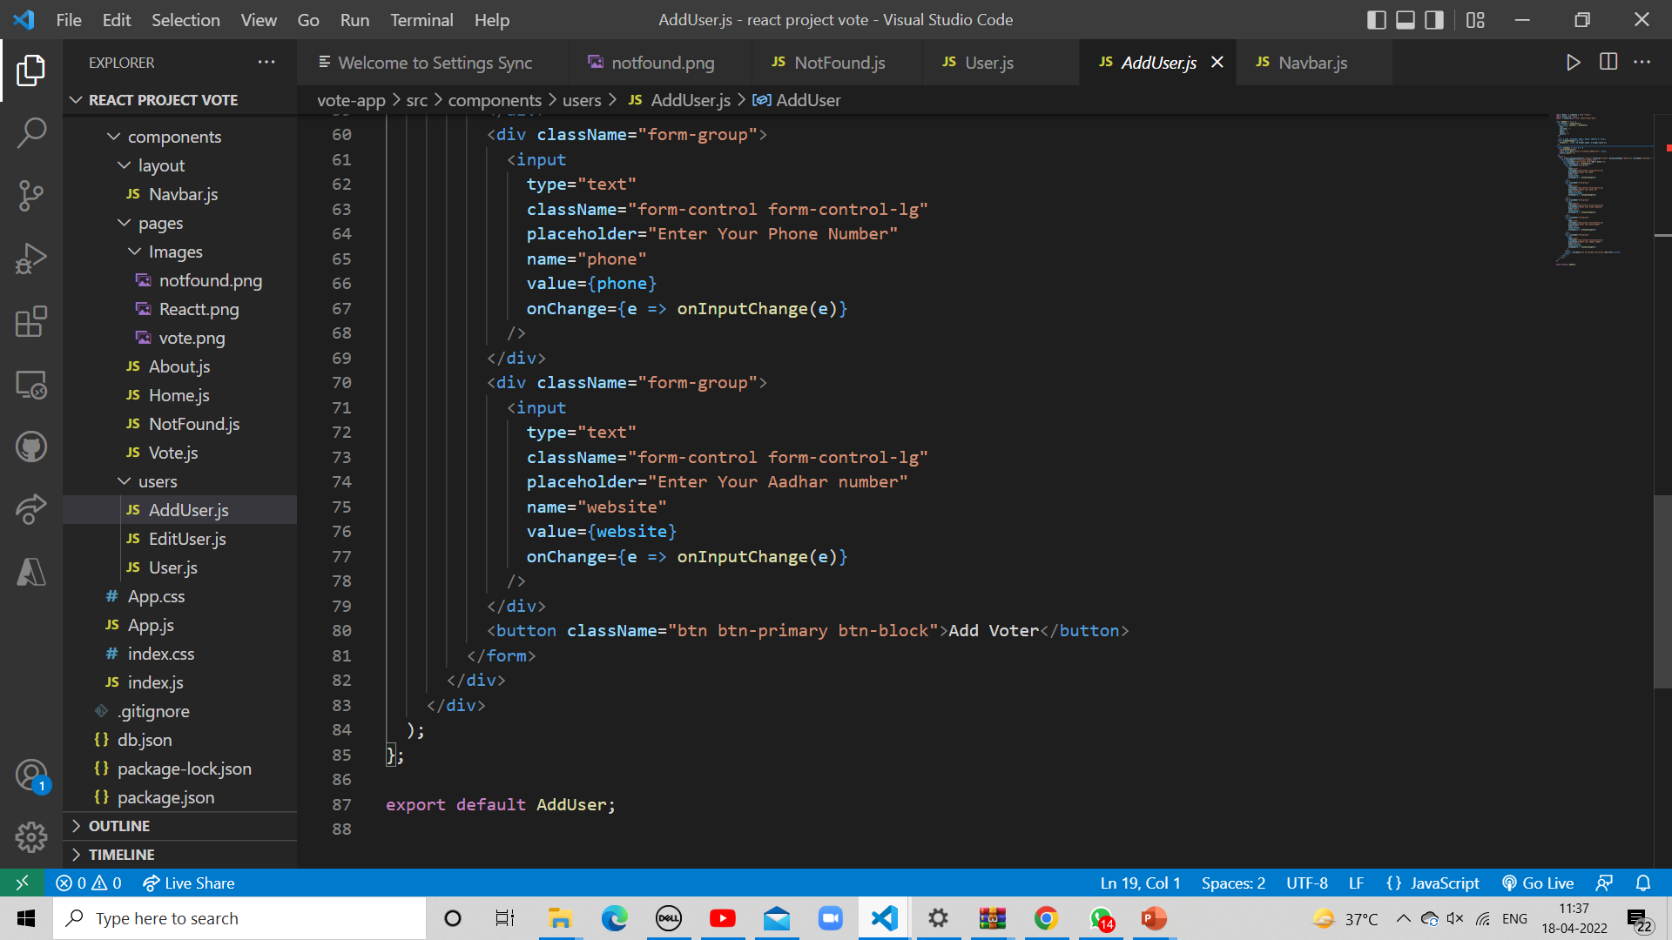

Slide 26
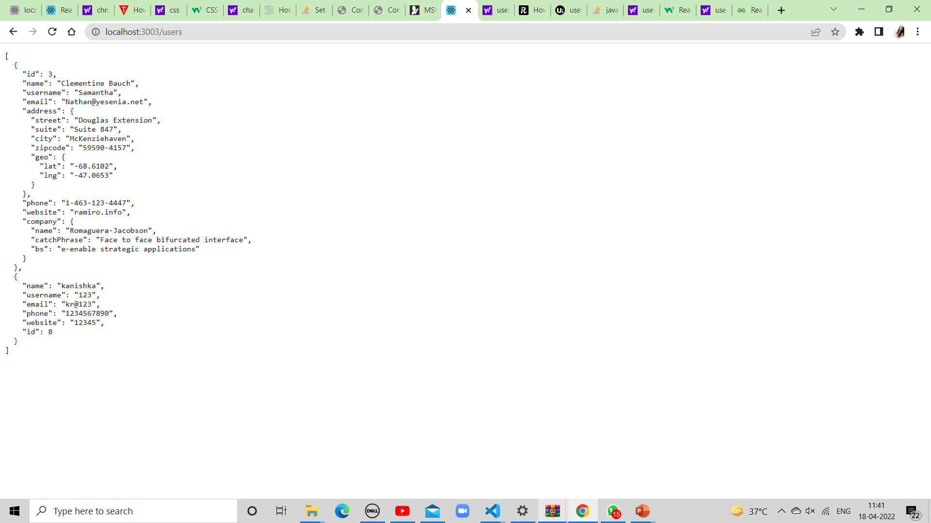
Database(json-server)

Slide 27
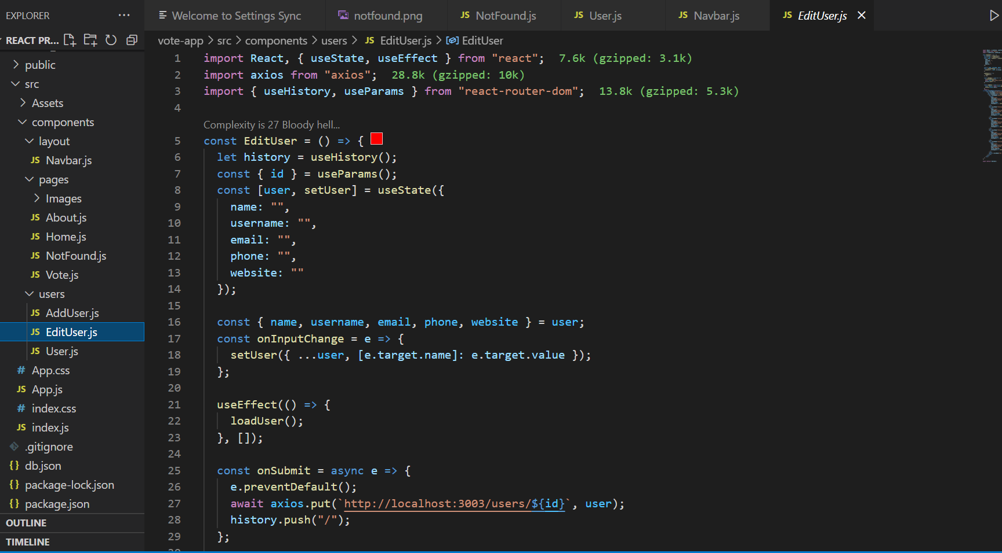
EDIT.JS

Slide 28
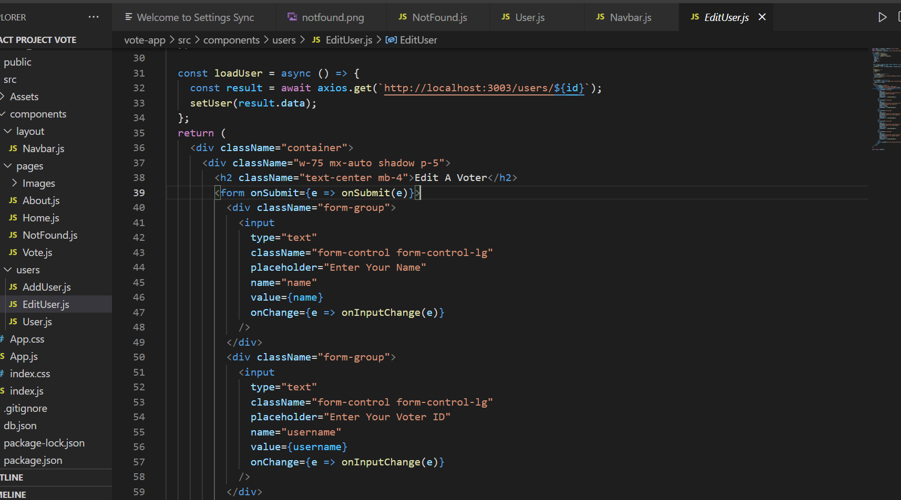

Slide 29
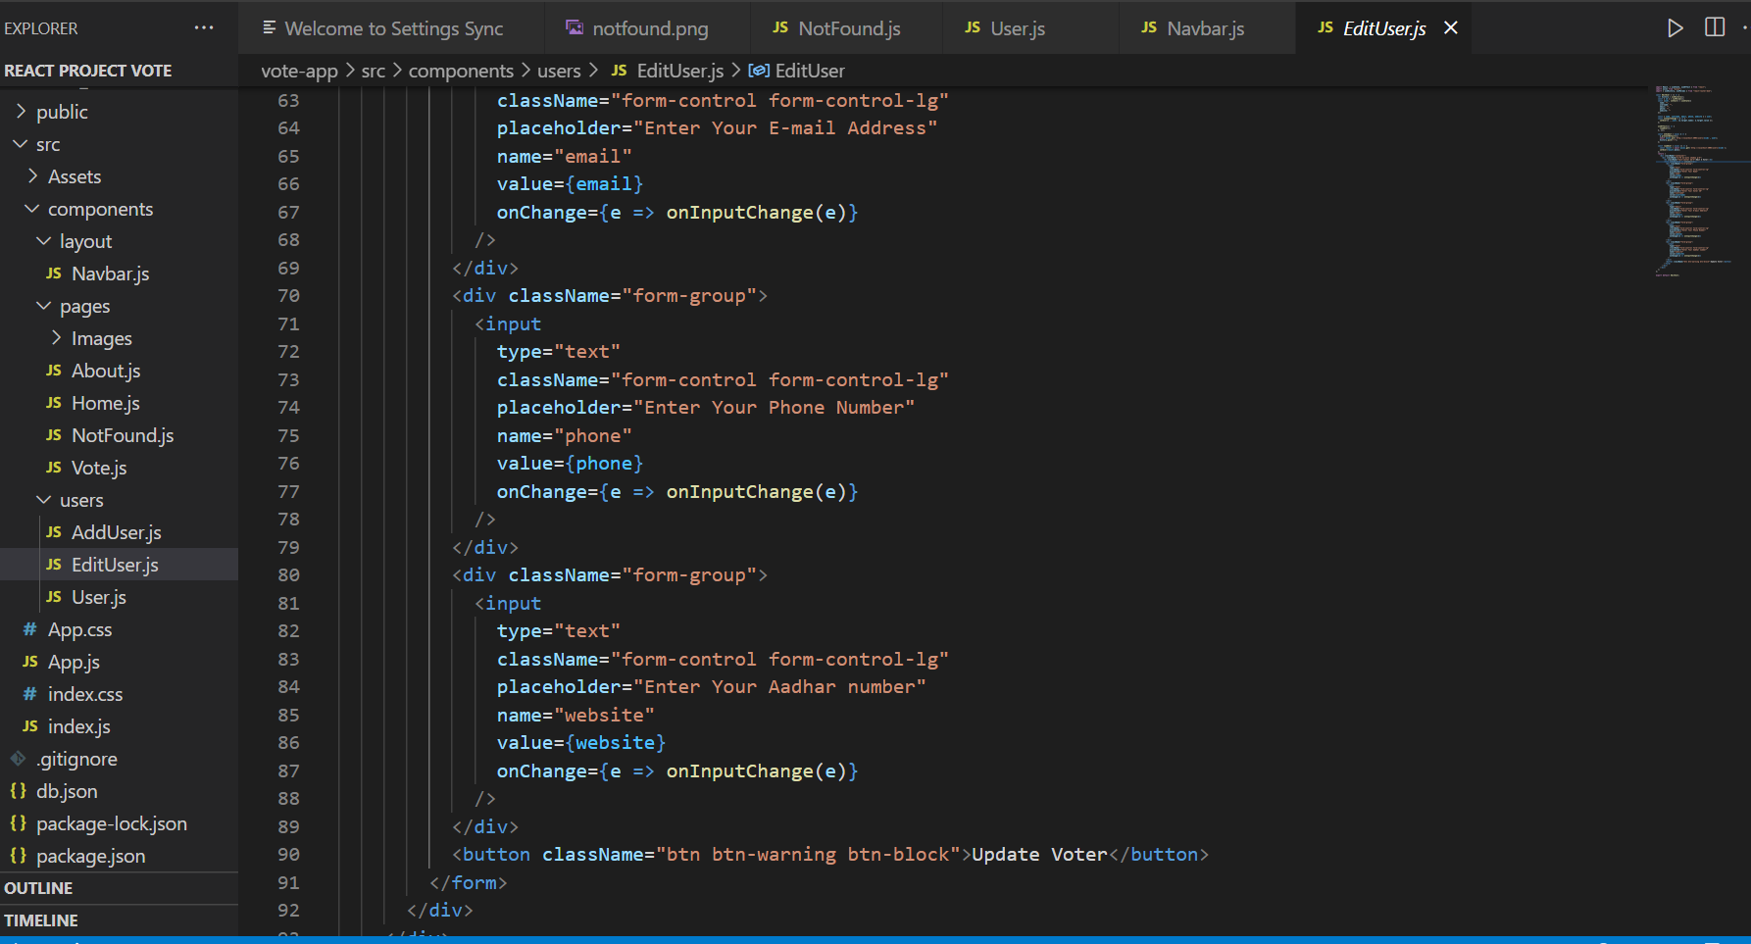

Slide 30

THANK-YOU

